Slide 1
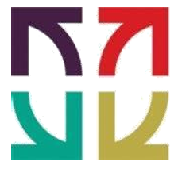
Sign Language Interpreter using Deep Learning
Under the guidance of : Asst. Prof. Pushplata Dubey
Rajiv Gandhi Institute of Technology
Chola Nagar, Bengaluru, Karnataka - 560032
Bahaduri Prachiti Jagdish - 1RG17CS009
Mohammed Azim - 1RG17CS030
Mohammed Touseef - 1RG17CS031
Prajwal B Mani - 1RG17CS037

Slide 2
ABSTRACT
Speech Impairment is a disability, which affects an individual’s ability to communicate using speech and hearing. This brings about the difficulty for both the sign and non - sign language speakers to communicate with each other. With recent advances in deep learning and computer vision, the focus of our project is to create a vision of an end to end Convolutional Neural Network that will be trained on the ASL(American Sign Language) dataset then modeled on robust architectures like GoogLeNet/MobileNet architecture and deploy it on an android application so that it will have more accessibility and provides an ease of use, thus aiding communication between signers and non-signers. It is a challenging and interesting problem that if solved will bring a leap in social and technological aspects alike.

Slide 3
MOTIVATION
Communication is one of the basic requirements for survival in society.
The lack of ISL dataset and often leads to obscurity of features due to overlapping of hands this leads us to use ASL.
Our project aims at taking the basic step in bridging the communication gap between normal people and deaf and dumb people.
Effective extension of this project to words and common expressions may not only make the deaf and dumb people communicate faster and easier with outer world, also providing a boost in developing autonomous systems for understanding and aiding them.

Slide 4
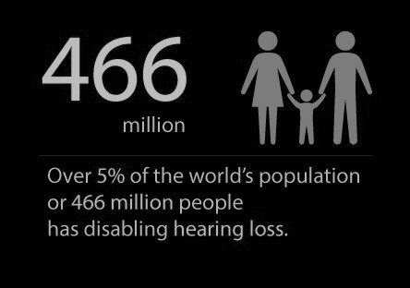
PROBLEM IDENTIFICATION
According to the projection of data it is expected to rise to 900 million by 2050 that is double the current stats.
Hearing loss can affect a person in three main ways:
Education
Job
Social Withdrawal

Slide 5
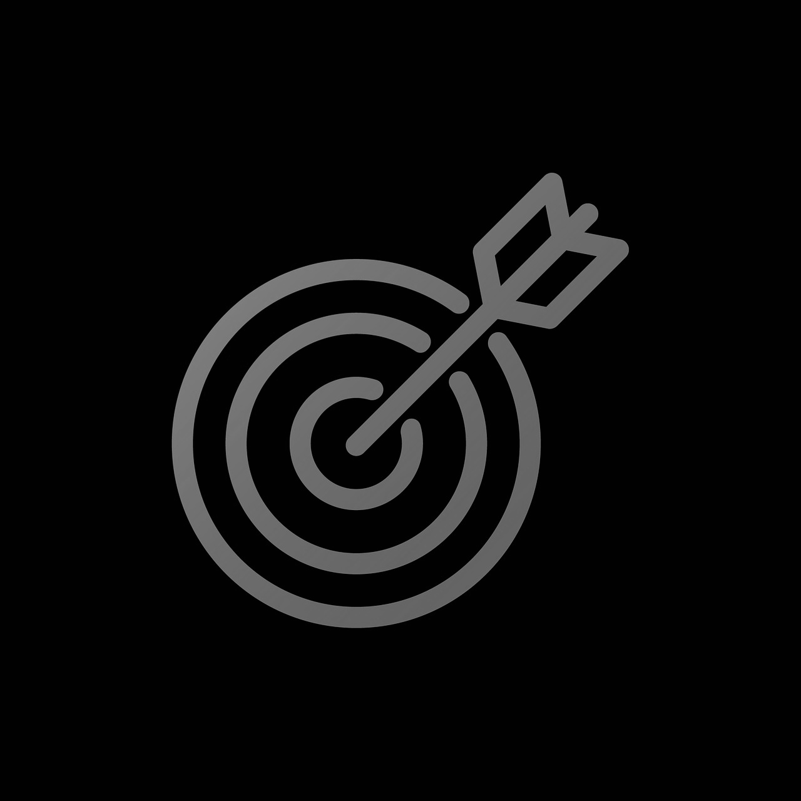
OBJECTIVES
Create a robust android application that aids in communication for deaf people.
Use deep learning with transfer learning techniques to build a neural network model that as to ability to learn pattern in video and classify the images.
An error correction model for identifying the pattern mismatch and correcting it for the audio or text input format.
To build a model that has higher accuracy with less bias and overfitting problems.
To enhance the model to classify at least 20 classes or more .

Slide 6
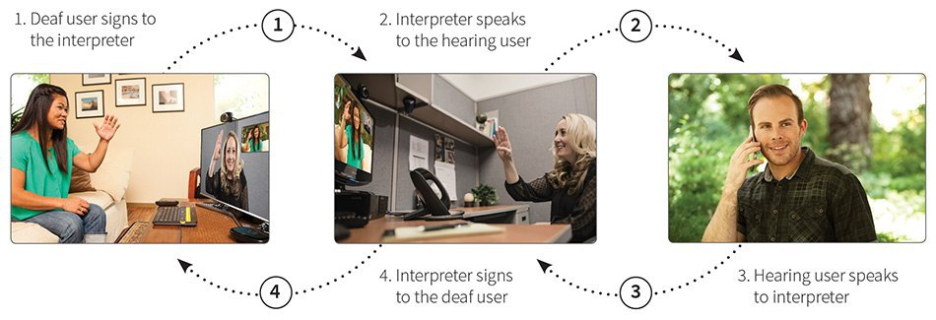
EXISTING SYSTEM
Traditional - based approach
A sign language interpreter is a person trained in translating between a spoken and a signed language.

Slide 7
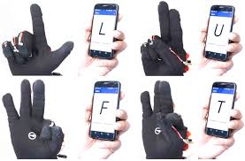
EXISTING SYSTEM
Glove - based approach
The signers are required to wear a sensor glove.
The task will be simplified during segmentation process by wearing glove.

Slide 8
DRAWBACKS
Lack of availability of the interpreter for that moment.
The gloves based approach is that the signer has to wear the sensor hardware along with the glove during the operation of the system.
The cost of traditional based approach will vary from 100 to 200 dollars/hrs and for gloves based approach its costs around 40,000 dollars / pair

Slide 9
PROPOSED SYSTEM
We have introduced a refined approach using advanced deep learning techniques that is flexible to use by any mobile OS. In this presentation, we propose an architecture to detect signs. Image pre-processing makes the existing data and input data normalized. The pipeline allows us to automate machine learning workflow. Transfer learnings make it easy to make the models to learn even small details that are hard to capture in a small network. Kivy gives us an advantages overview by giving us a docile structure to compile to any version of the mobile app.

Slide 10
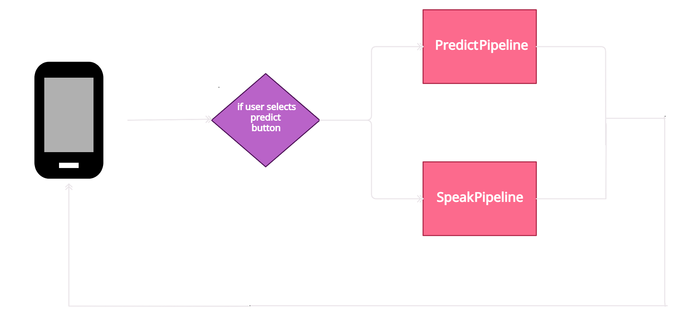

ARCHITECTURE OF PROPOSED SYSTEM

Slide 11
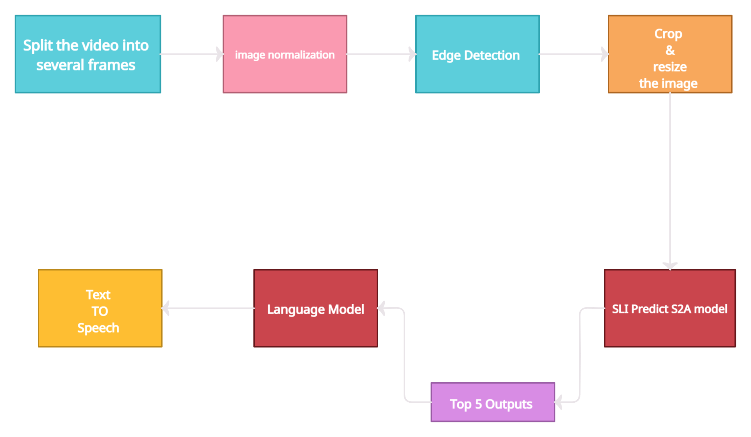
PREDICT PIPELINE

Slide 12
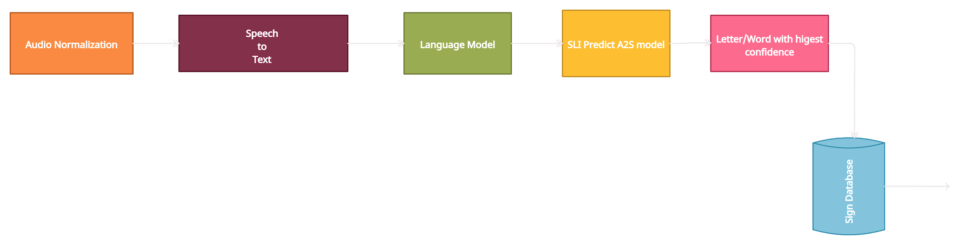
SPEAK PIPELINE

Slide 13


HARDWARE AND SOFTWARE REQUIREMENT SPECIFICATION
HARDWARE REQUIREMENTS:
For Typical Operating System (Windows 10)
Intel Core i3-3rd gen processor or later.
8GB RAM & 120GB disk space
A good GPU support
I/O devices
Any external or inbuilt camera with minimum pixel resolution 200 x 200 (300pi or 1501pi) 4-megapixel cameras and up.

Slide 14





HARDWARE AND SOFTWARE REQUIREMENT SPECIFICATION
SOFTWARE REQUIREMENTS:
Front End : Android (using Kivy )
Video & image processing : Open CV, scikit-image
Neural Network Modeling : Tensorflow(tf.lite), Keras, Pytorch
Architectures : Google LeNet, MobileNet, VGG 19
Ubuntu : deploying .apk using buildozer kivy
Editor : Visual code, jupyter notebook

Slide 15
POSSIBLE OUTCOME OF THE PROJECT
UI Interface to access model functionalities
Improved accuracy
Dynamic Tracing
Continuous integration pipelines that enable model redeployment

Slide 16
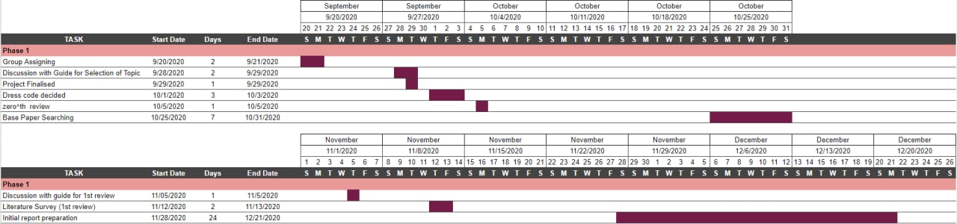
GANTT CHART

Slide 17
CONCLUSION
A sign language is a natural mode of communication used by the deaf community. India has large population of speech and hearing impaired but a very small number of certified sign language interpreters are available. Research in hand gesture recognition has gained attention with advancement in the field of computer vision. A Sign Language Interpreter (SLI) decodes and understands the information conveyed by signs. SLI can be a major breakthrough in helping a common people to communicate with the deaf and can help in bridging this communication gap. A SLI can be designed based on video/image processing and deep learning techniques which requires a standard dataset, determination of an optimal feature set, and an appropriate classification technique.

